Slide 1


HACKER EYE
PARUL INSTITUTE OF ENGINEERING & TECHNOLOGY
FACULTY OF ENGINEERING & TECHNOLOGY
PARUL UNIVERSITY
PRESENTED BY :
PRIYA BANIK(2203031057091) GUIDE: KUNTAM SUTHAR
PAKALAPATI NAGA SURYA(2203031247027) DESIGNATION: LECTURER
BADAM SAI SATHWIK(210303124215) CSE DEPARTMENT
ARUMILLI G S NAVANEETH(210303124202) PIET, PARUL UNIVERSITY
PARUL INSTITUTE OF ENGINEERING & TECHNOLOGY, PARUL UNIVERSITY

Slide 2
CONTENT
Introduction
Problem Statement
Research Paper Summary (in Tabular form)
Flowchart of the system
Implementation Details
Demonstration of the Project
Testing
Test cases
Conclusion
Future Work
References
PARUL INSTITUTE OF ENGINEERING & TECHNOLOGY, PARUL UNIVERSITY

Slide 3
INTRODUCTION
Hacker Eye: To detecting the virus present in the data.
Opening Statement:
Imagine a world where your files and Url’s are containing full of viruses, here you can upload and paste links that can detect the malicious data in real –time that will provide you full safety and security of your data to not loose.
Background:
Introduce Hacker Eye as an innovation platform designed to bring more efficiency, security and flexibility to use the website. Emphasize that Hacker Eye is a place where — it’s give the result of your data, that will protect your information of which you are searching and this website give guarantee that your data will be confidential, it won’t be lose.
PARUL INSTITUTE OF ENGINEERING & TECHNOLOGY, PARUL UNIVERSITY

Slide 4
Problem Statement
Title: The Challenges We Addressed
This website can be access only when user will create account.
Multiple time access can make the system slow.
It is available for free of cost only for three times access per user.
Malicious actors continually evolve their techniques.
A detection system may struggle to keep up with new and sophisticated threats, requiring constant updates and improvements.
PARUL INSTITUTE OF ENGINEERING & TECHNOLOGY, PARUL UNIVERSITY

Slide 5
Background Study
Sr. number | Paper Title | Publisher | Year | Take-away position
1 | Computer virus strategies and detection methods | Essam AI Daoud, Iqbal Jebril, Belal Zaqaibeh | 2008 | Develop methods to detect all metamorphic virus variants. Implement reliable techniques for discovering new viruses. Use digital signatures and certificates for software security. Address challenges in preventing virus infections with traditional antivirus approaches.
2. | A Study Of Cyber Security Challenges And Its Emerging Trends On Latest Technologies | Nikhita Reddy Gade , Ugander G J Reddy | 2014 | Cybersecurity is crucial amid rising cyber crimes, with ongoing challenges despite preventive efforts. The paper highlights emerging technology issues, recent cybersecurity advancements, and evolving trends and ethics.
3. | Malware Analysis and Detection Using Machine Learning Algorithms | Muhammad Shoaib Akhtar , Tao Feng | 2022 | Polymorphic malware evades traditional detection by changing its signature. Machine learning algorithms(DT, CNN, SVM) showed high accuracy and low false. positives in detecting malware. Confusion matrix analysis confirmed these algorithms' effectiveness in improving network security.
4. | Research on threat detection in cyber security based on machine learning | Qiwei Ke | 2021 | Modern Techniques: The essay will explore advanced machine learning and deep learning methods for intrusion, malware, and vulnerability detection. Comparison: It will compare traditional methods with new machine learning approaches, detailing their performance differences. Research Insights : The essay will review recent research projects to show how current models work, along with discussing their challenges and potential improvements.
PARUL INSTITUTE OF ENGINEERING & TECHNOLOGY, PARUL UNIVERSITY

Slide 6
Background Study
Sr. number | Paper Title | Publisher | Year | Take-away position
5. | Ethical Hacking: An Impact On Society | Meenaakshi N. Munjal | 2014 | Ethical hacking involves finding system vulnerabilities with good intentions. Perception: Hackers are often viewed negatively due to criminal activities, but ethical hackers aim to prevent such issues. Importance: They help uncover hidden vulnerabilities, crucial since 90% of attacks come from insiders. Ethical Concerns: The field faces challenges regarding hackers' true intentions and the need for ethical practices.
6. | The Role of Machine Learning in Cyber security | Giovanni Apruzzese, Pavel Laskov, Edgardo Montes de Oca, Wissam Mallouli, Luis Búrdalo Rapa, Athanasios Vasileios Gram matopoulos, and Fabio Di Franco. | 2023 | ML's Emerging Role: Machine Learning is becoming crucial in cybersecurity but is still in early stages, with a notable gap between research advancements and practical applications. Benefits and Challenges: ML offers significant advantages over traditional methods, including handling tasks beyond human capability, but faces challenges in real-world deployment that need to be addressed. Future Progress and Collaboration: Effective advancement of ML in cybersecurity requires broad understanding and collaboration among researchers, practitioners, and policymakers, highlighted by real-world case studies demonstrating its potential.
7. | Ransomware Analysis using Feature Engineering and Deep Neural Networks | Arslan Ashrafa , Abdul Aziza , Umme Zahooraa , Muttukrishnan Rajarajanc and Asifullah Khan*a | 2018 | The study focuses on detecting ransomware using machine learning by analyzing key attributes and behaviors. Feature engineering is employed to identify distinct ransomware characteristics for detection. Both conventional machine learning and Transfer Learning with Deep Convolutional Neural Networks are used for detection. Two datasets, static (3646 samples: 1700 Ransomware, 1946 Goodware) and dynamic, were generated for feature analysis.
8. | How to Prevent Data Loss: Essential Strategies for Secure Data Management | Zoran Cocoara | 2023 | Data loss is a critical concern for all professionals, essential for organizational resilience. It can result from accidental deletions or advanced cyberattacks, requiring both technical and strategic responses. The impact of data loss includes financial damage, reputational harm, and legal issues.
PARUL INSTITUTE OF ENGINEERING & TECHNOLOGY, PARUL UNIVERSITY

Slide 7
Background Study
Sr. number | Paper Title | Publisher | Year | Take-away position
9. | Ensuring Data Integrity in Storage:Techniques and Applications | Gopalan Sivathanu | 2005 | Introduction to Data Integrity: Data integrity is key for secure and reliable storage, especially with new technologies and network storage introducing new failure modes. Causes of Integrity Violations: The paper discusses various causes of data integrity issues and the need for effective assurance methods. Survey of Assurance Techniques: A review of current data integrity techniques, their broader applications, and related implementation challenges. Mechanism Choices and Trade-offs: Analysis of different integrity assurance methods, detailing their choices and trade-offs. Introduction of Logical Redundancy: A new class of integrity assurance techniques using logical redundancy is introduced, offering improved efficiency and seamless integrity checks.
10. | Understanding malware behaviour through traffic analysis | Marta Galindo Quintana | 2022 | The project, a Master’s thesis in Cybersecurity from Universitat Politècnica de Catalunya (with Aalborg University Copenhagen), analyzed the TrickBot banking trojan's traffic behavior. A closed sandbox environment with Cuckoo Sandbox and VirtualBox was created for dynamic analysis of TrickBot binaries. After initial failures, a second environment was deployed to simulate attacks and understand credential stealing, resulting in a successful project and guide for future malware analysis.
11. | Windows Malware Detection Based on Cuckoo Sandbox Generated Report Using Machine Learning Algorithm | Shiva Darshan S.L.1, Ajay Kumara M.A.2, and Jaidhar C.D.3 | 2024 | Signature-based malware detection is limited with new threats, so dynamic analysis in a sandbox like Cuckoo is used to monitor behavior. System calls from the sandbox are converted into NGrams and analyzed with Information Gain (IG) for feature selection. Testing with WEKA classifiers shows SPegasos performs best, with highest accuracy, True Positive Rate (TPR), and lowest False Positive Rate (FPR).
12. | Survey of machine learning techniques for malware analysis | Daniele Ucci , Leonardo Aniello , Roberto Baldoni | 2018 | Machine Learning in Malware Analysis: Machine learning is increasingly used to handle the growing complexity and volume of malware by learning patterns and models to adapt to evolving threats. Survey Objectives: This survey reviews how machine learning techniques are applied to analyze Portable Executables in Windows environments, focusing on objectives, features used, and algorithms employed. Systematic Review: The survey organizes papers based on their goals, feature usage, and machine learning methods, highlighting issues with datasets and identifying current trends. Economic Considerations: A new concept, "malware analysis economics," is introduced, examining the trade-offs between analysis accuracy and cost.
PARUL INSTITUTE OF ENGINEERING & TECHNOLOGY, PARUL UNIVERSITY

Slide 8
Background Study
Sr. number | Paper Title | Publisher | Year | Take-away position
13. | Machine Learning: Algorithms, Real-World Applications and Research Directions | Iqbal H. Sarker | 2021 | The paper reviews ML algorithms (supervised, unsupervised, semi-supervised, reinforcement) and deep learning for various applications. It highlights their use in fields like cybersecurity, smart cities, healthcare, e-commerce, and agriculture. Challenges and research directions are discussed, serving as a guide for academics, professionals, and decision-makers.
14. | Review of Viruses and Antivirus Patterns | Yusuf Muchelule , Neyole Misiko | 2017 | Computer Viruses: Self-replicating code that spreads, altering files and programs. Virus Patterns: Specific instructional code patterns that persist in systems. Antivirus Programs: Detect viruses using updated databases of known patterns. Updating: Frequent database updates are essential to counter new viruses.
15. | Existing Evidence for the Effectiveness of Antivirus in Preventing Cyber Crime Incidents | David Maimon | 2019 | Research Scope: Studies assess antivirus effectiveness against malware and cyber crimes. Search Criteria: Reviewed publications from 2000-2016 using experimental or quasi-experimental designs. Evaluation Approaches: Different methods are used to measure antivirus performance, including comparisons and benchmarks. Key Findings: Results show varied effectiveness and assessment approaches for antivirus software.
16 | Cyber Security Tool Kit (CyberSecTK): A Python Library for Machine Learning and Cyber Security | Ricardo A. Calix *, Sumendra B. Singh, Tingyu Chen, Dingkai Zhang and Michael Tu | 2020 | Purpose: CyberSecTK is a Python library designed for preprocessing and feature extraction of cyber-security data, facilitating the integration of machine learning into cybersecurity tasks. Goal: The toolkit aims to bridge the gap between cybersecurity experts and machine learning by providing a straightforward way to process common cyber security data and build basic ML pipelines. Components: The library includes modules, data sets, and tutorials to support research and teaching in cybersecurity, with use cases and student feedback demonstrating its practical applications.
PARUL INSTITUTE OF ENGINEERING & TECHNOLOGY, PARUL UNIVERSITY

Slide 9
Background Study
Sr. number | Paper Title | Publisher | Year | Take-away position
17. | A New Approach to Data Analysis Using Machine Learning for Cybersecurity | Shivashankar Hiremath, Eeshan Shetty, Allam Jaya Prakash , Suraj Prakash Sahoo , Kiran Kumar Patro , Kandala N. V. P. S. Rajesh , and Paweł Pławiak | 2023 | Increased internet use heightens vulnerability to cyber-attacks, especially on customer-facing sites and apps. Data analysis tools like Power BI identify and address these vulnerabilities. The aim is to provide insights for effective security measures to protect digital assets.
18. | A Comparative Analysis of VirusTotal and Desktop Antivirus Detection Capabilities | Christoforos Ntantogian , Emmanouil Magkos , Stylianos Karagiannis, Vassilios S. Verykios | 2022 | VirusTotal Usage: VirusTotal is widely used for classifying files as malicious or not, but the reliability of its antivirus engines is not well understood. Evaluation of Detection Results: The study compares the detection results of VirusTotal antivirus engines with their desktop counterparts. Findings: VirusTotal engines generally have a lower malware detection rate than desktop engines due to a lack of cloud-based detection capabilities.
19. | A Comparative Study on Detection of Malware and Benign on the Internet Using Machine Learning Classifiers | J. Pavithra and S. Selvakumara Samy | 2022 | Increased network usage has heightened vulnerability to phishing attacks. Research seeks to enhance phishing detection by evaluating Random Forest, SVM, and Naïve Bayes classifiers. Random Forest was most effective, achieving 99.47% accuracy and a 1.7% false-positive rate, though spoofing detection remains challenging.
20. | Database Security Threats and Challenges | Abdulazeez Mousa , Twana Mustafa, Murat Karabatak | 2020 | Increased Risks: Growing Internet use heightens database risks and attack frequency. Database Threats: Threats involve entities that could misuse or manipulate confidential data. Security Gaps: Many businesses fail to adequately secure their databases. Protection Priority: Databases need more robust security than other systems. Paper Focus: The paper highlights threats, challenges, and safety models for sensitive data. Study Assumption: Identifying database weaknesses helps in developing effective security strategies.
PARUL INSTITUTE OF ENGINEERING & TECHNOLOGY, PARUL UNIVERSITY

Slide 10
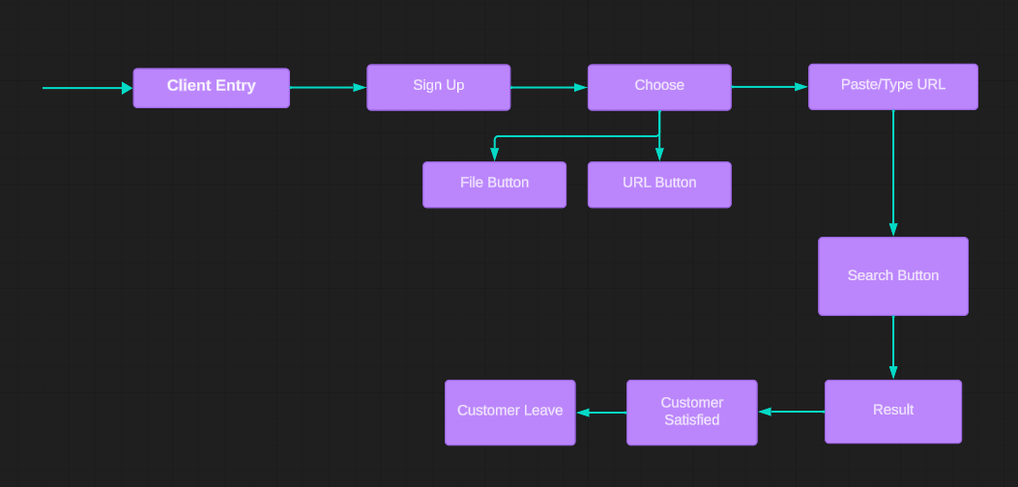
Flowchart of the system
Hacker Eye
PARUL INSTITUTE OF ENGINEERING & TECHNOLOGY, PARUL UNIVERSITY

Slide 11
Implementation Details
Title: Turning Ideas into Reality
Introduction:
Building Hacker Eye was a journey that involved meticulous planning, coding and testing to ensure for the users.
Features Breakdown:
Real-time Chat System:
Utilized WebSocket technology to enable instant communication between customers and developers, reducing response times.
Payment Integration:
Introduced a 'Become a Seller' feature that attracted safety and security to the platform. Integrated Stripe to provide secure and smooth payment processing after 3 times usage of per user.

Slide 12
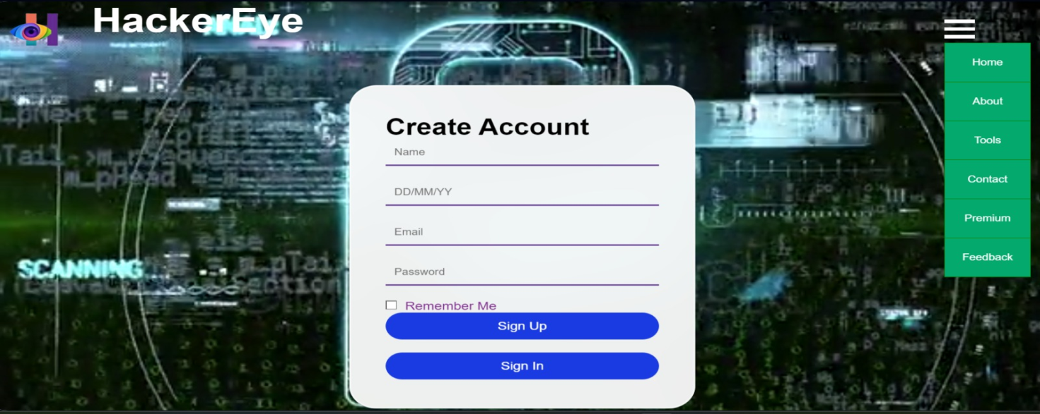

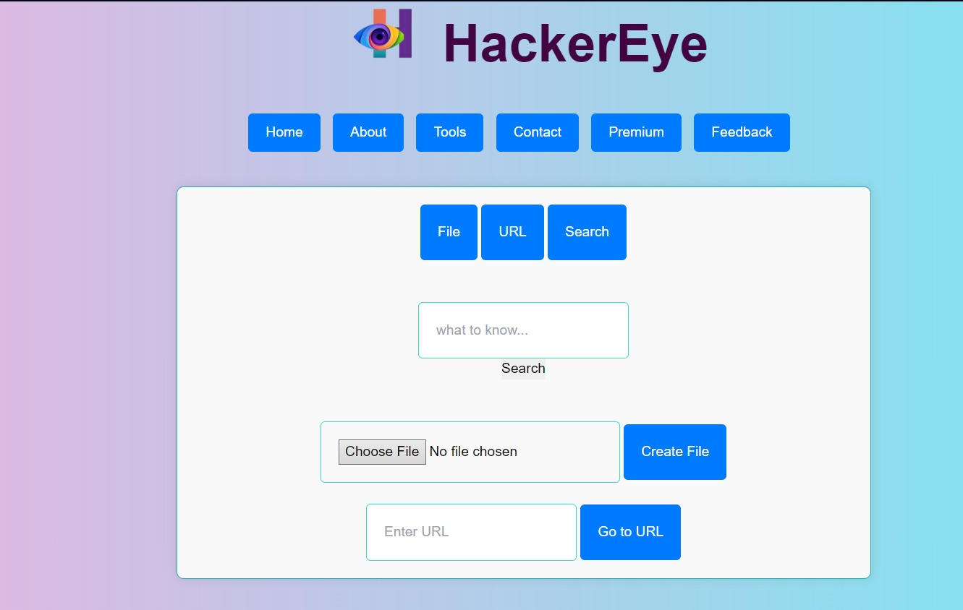

Screenshot Of Implementation Details
PARUL INSTITUTE OF ENGINEERING & TECHNOLOGY, PARUL UNIVERSITY

Slide 13

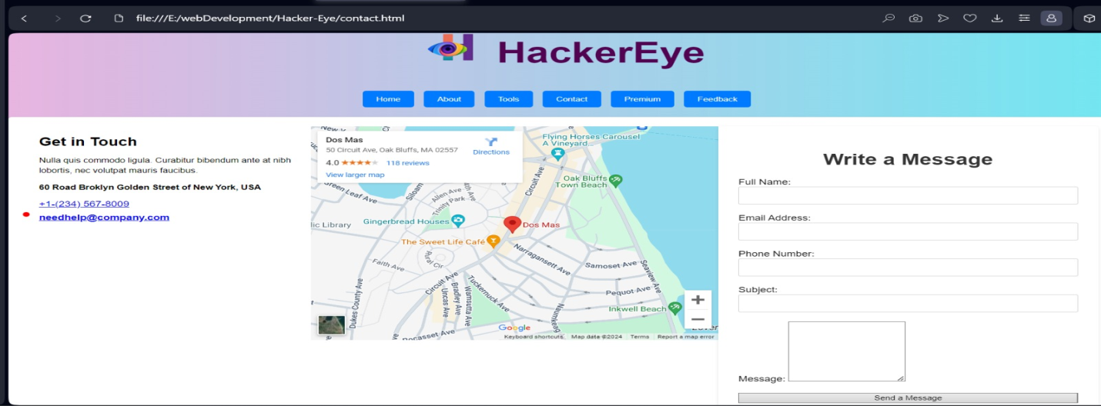
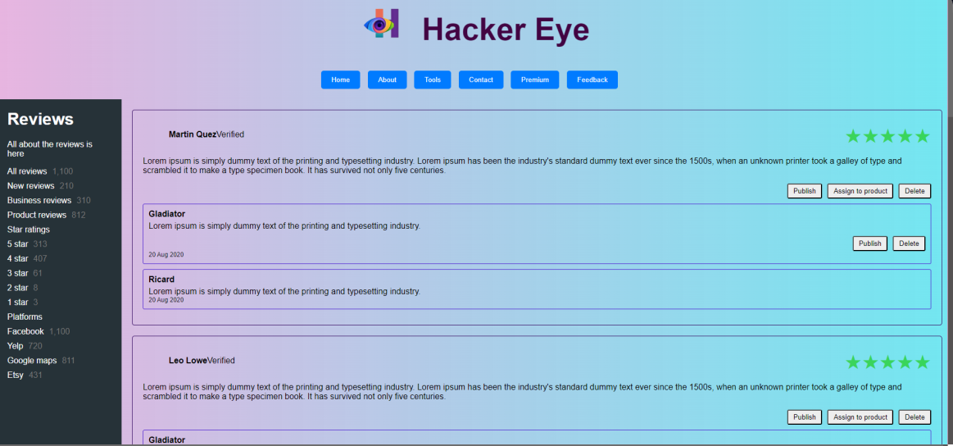
Continue…
PARUL INSTITUTE OF ENGINEERING & TECHNOLOGY, PARUL UNIVERSITY

Slide 14
Testing Of The Project
Title: Ensuring Reliability and Performance
Content:
Introduction:
Thorough testing was critical to ensuring that Hacker Eye satisfy the data smoothly under various malware and provides a reliable user experience and safety to go through the data.
Testing Cases:
Unit Testing: Ensured each component works correctly in isolation.
Integration Testing: Checked how different components interact with each other.
System Testing: Evaluated the overall performance and security of the platform.
PARUL INSTITUTE OF ENGINEERING & TECHNOLOGY, PARUL UNIVERSITY

Slide 15
Conclusion
Title: Reflecting on Our Journey
Content:
Summary:
Hacker Eye website is very useful for a user for detecting and analyzing which URLs or files is safe to access. Hence, by using this website, we can know the that the data containing malicious or not.
Key Takeaways:
If user facing any sort of problem can contact as through sending us the problem in writing box which has been given specially.
PARUL INSTITUTE OF ENGINEERING & TECHNOLOGY, PARUL UNIVERSITY

Slide 16
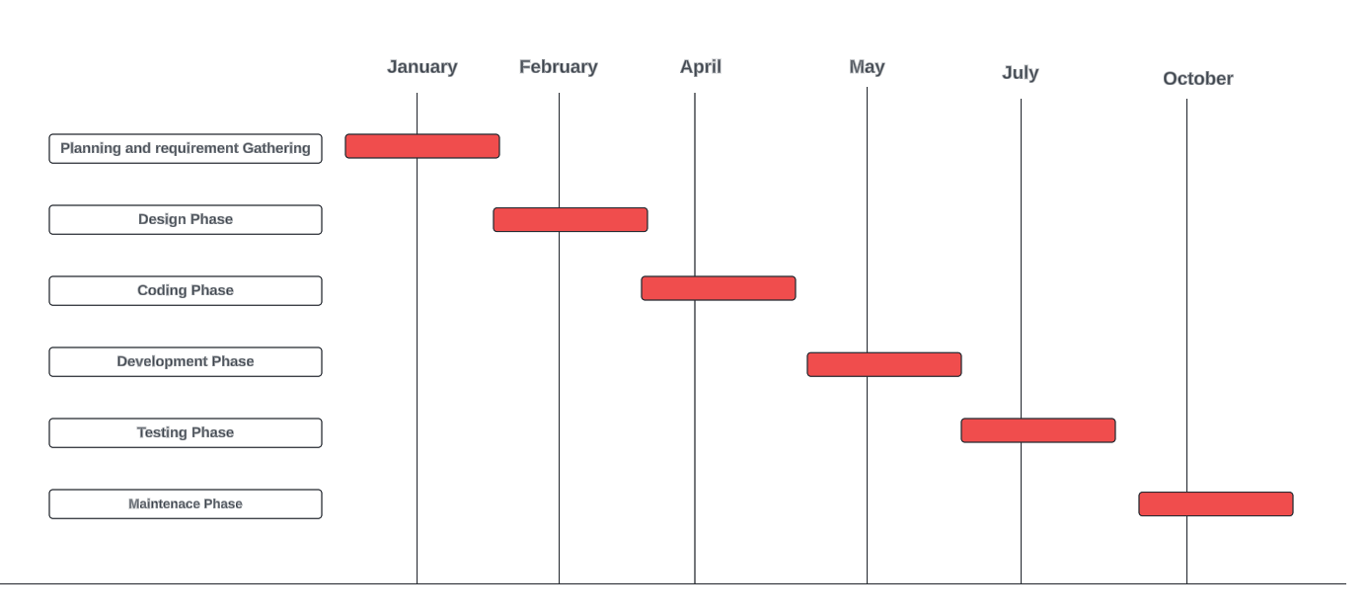
Time Line Chart - Schedule
PARUL INSTITUTE OF ENGINEERING & TECHNOLOGY, PARUL UNIVERSITY

Slide 17
Technology
Frontend Technology:-
HTML
CSS
JavaScript
Backend Technology:-
Language :- Python(Flask)/JAVA
Programming Language: Machine Learning
Server: Web Scoket
PARUL INSTITUTE OF ENGINEERING & TECHNOLOGY, PARUL UNIVERSITY

Slide 18
Future work
Title: Looking Ahead
Future Enhancements:
AI-Based Recommendations: Implementing machine learning to provide personalized data result recommendations.
Mobile App Development: Creating a mobile app to make scanning even more convenient and adding more and new antiviruses.
Expansion of Product Categories: Adding more features and categories to cater to a wider audience.
PARUL INSTITUTE OF ENGINEERING & TECHNOLOGY, PARUL UNIVERSITY

Slide 19
References
Title: Acknowledging Our Sources
References List:
https://www.virustotal.com/gui/home/url
https://github.com/mainio/decidim-module-antivirus
https://github.com/virustotal
https://www.kaggle.com/
https://hackerseye.net/
https://core.ac.uk/download/pdf/80994982.pdf
PARUL INSTITUTE OF ENGINEERING & TECHNOLOGY, PARUL UNIVERSITY

Slide 20
References Continue..
References List:
Malware Analysis and Detection Engineering by Abhijit Mohanta, Anoop Saldanha.
Introduction to cyber security: Guide to the World of Cyber Security by Anand Shinde.
https://info.opswat.com/
www.google.com/
www.blackbox.ai
https://www.bing.com
PARUL INSTITUTE OF ENGINEERING & TECHNOLOGY, PARUL UNIVERSITY

Slide 21
THANK YOU
PARUL INSTITUTE OF ENGINEERING & TECHNOLOGY, PARUL UNIVERSITY

